Slide 1
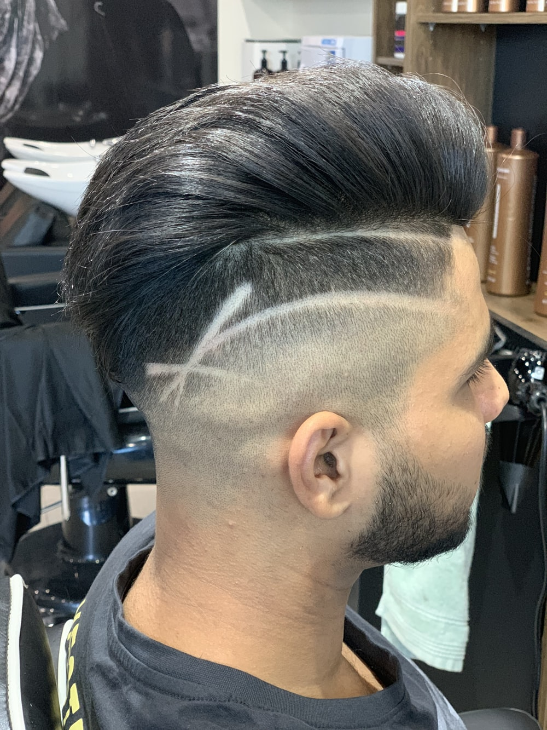
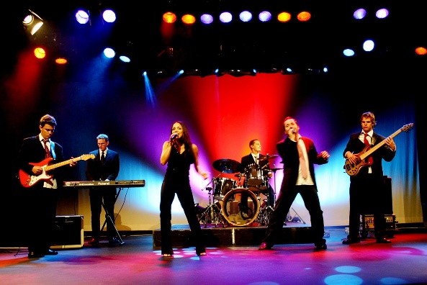
Conversation Class
Fill the picture
Christopher bAUMAN

Slide 2
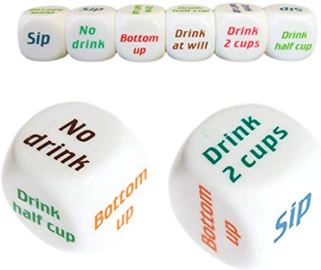
Education Infographic
Complements
Daily routine
Exercise
Energy
Time
Posture
Goals
Motivation
Good person
Manners
Chris Bauman

